Slide 1
Object and Face Detection
Using ML libraries in Python

Slide 2
Machine Learning Infographics
Machine Learning (ML) is a dynamic and rapidly evolving field of artificial intelligence (AI) that focuses on the development of algorithms and models designed to enable computers to learn and make decisions autonomously from data. ML aims to empower machines to identify patterns, relationships, and insights within data, making it an invaluable tool for addressing complex problems

Slide 3
Machine Learning
01
Data
04
Evaluation
evaluated on new, unseen data
high-quality data are essential for the success
Algorithms
02
Predictions
05
mathematical procedures and models that facilitate learning
enabling automation and real-time decision
Train the model
03
historical data to recognize patterns and relationships

Slide 4
Machine Learning Appliactions
Computer Vision
object detection, and facial recognition
Some machine learning applications
Natural Language Processing
language understanding, translation, sentiment analysis
Healthcare
disease diagnosis, drug discovery
Finance
fraud detection, stock market prediction

Slide 5
Project Overview
Broadly, this project can be divided into two parts those are _Object detection and _Face Detection, further _Face Detection can also be divided into two sub parts those are face detection for saved image and for real-time Footage(Live). To make our machine learning applications accessible and user-friendly, I employed Streamlit, a Python library that enables us to develop interactive web applications. I designed user interfaces that allow users to interact with machine learning models, providing an intuitive experience.

Slide 6
Object detection is a fundamental computer vision task with countless practical applications.
01
YOLO
02
known for its speed and accuracy in real-time object detection.
COCO Dataset
03
Object Detection
COCO dataset is a benchmark for object
detection tasks, containing over 200,000 images across 80 object categories.
OpenCV
providing a wide array of tools for image and video processing, including object detection.

Slide 7
Face Detection
Face Detection can also be divided into two sub parts those are face detection for saved image and for real-time Footage(Live).
Saved Image Face Detection
Real-time Face Detection

Slide 8
Real- Time Face Detection
Interactive GUI
01
The code utilizes PyQt5 to build an interactive graphical user interface
Real-Time Face Detection
02
The code harnesses OpenCV's pre-trained deep learning models for robust and accurate face detection.
03
Visual Feedback
ed faces are highlighted with bounding boxes

Slide 9
Saved Image Detectin
provides extensive support for image processing and manipulation.
OpenCV
MTCNN
Multi-Task Cascaded Convolutional Networks (MTCNN) model
employs cascaded networks to identify faces in an image efficiently.
Confidence
crucial role in distinguishing high-confidence detections from false positives

Slide 10
Working Methodology
Project is based on Python language version 3.11.4 . IDE used for writing the source code is Visual studio codes and also used platforms jupyter notebook and Google collab.
This project basically consists of three parts those are Object Detection, Face Detection –( Saved Image and Real-time). Each type of detector is made up of single function which are “object_detector(xyz)” for Object detection, “Live_face()” for Real-time face detection and “no_of_face(image_path,h)” for detecting face in given image.

Slide 11
Working Methodology…
Here, “object_detector(xyz)” takes xyz as input which is location of image. In “no_of_face(image_path,h)” image_path is path of image and h is the confidence_threshold. In “Live_face()” there are no arguments needed.
These three functions are present in single file named “webb.py” along with other code.

Slide 12
Working Methodology…
After merging all functions in single file, I have used “Streamlit”, so all components of the project are integrated into a single web application. Streamlit's intuitive interface allows users to effortlessly switch between object detection, real-time face detection, and image face detection modules, all within a web browser.
Source code of project contains many imported modules such as cv2, numpy, streamlit, mtcnn, PyQt5.

Slide 13
Working behind Object Detection
I have made “object_detector(xyz)” function for the object detection. Its code uses external modules, Numpy and opencv, which needed to be installed with command:
Then all these modules needs to be imported in code :

Slide 14
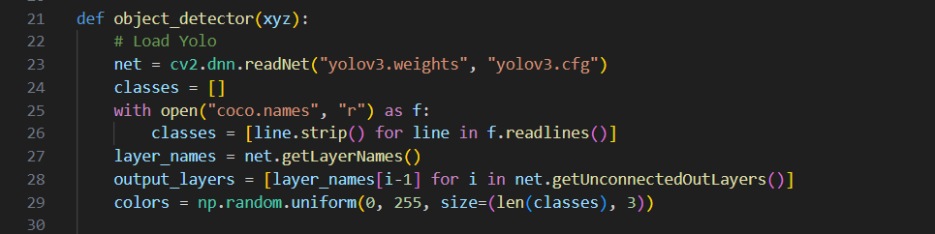
Working behind Object Detection….
Then we need to Load “YOLO”:
You Only Look Once (YOLO) is one of the most popular model architectures and object detection algorithms. It uses one of the best neural network architectures to produce high accuracy and overall processing speed, which is the main reason for its popularity.

Slide 15
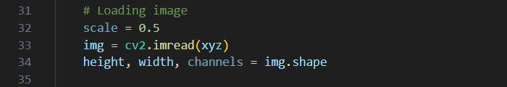
Working behind Object Detection….
YOLO algorithm aims to predict a class of an object and the bounding box that defines the object location on the input image. It recognizes each bounding box using four numbers:
Center of the bounding box ( b(x), b(y) )
Width of the box ( b(w) )
Height of the box ( b(h) )
Then we need to load image using cv2 module:

Slide 16
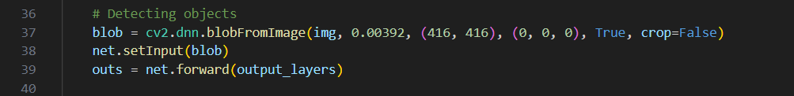
Working behind Object Detection….
Detecting Objects:
Repersenting information on screen in new window by using cv2 and numpy module:

Slide 17
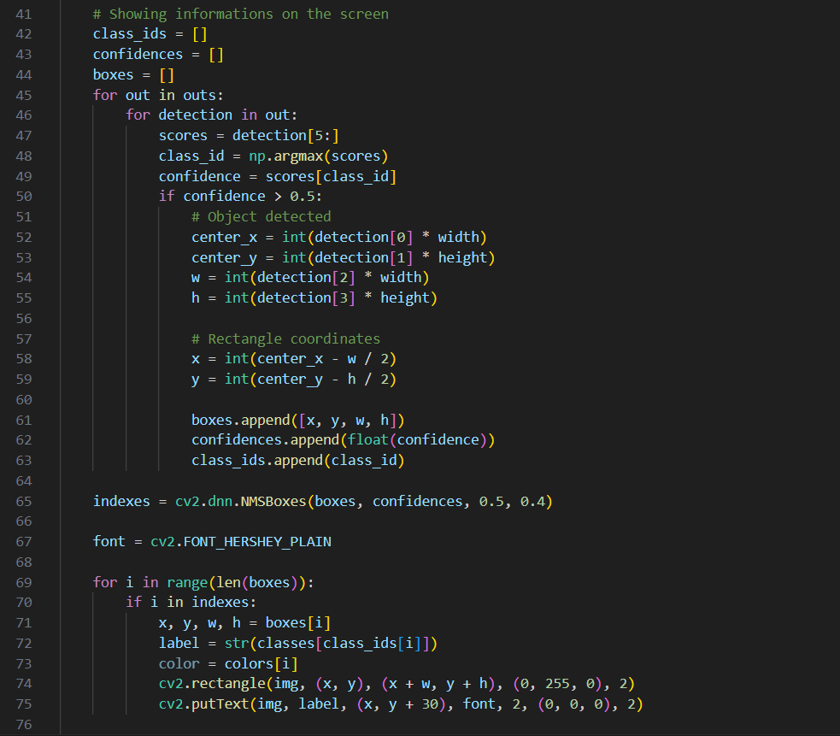
Working behind Object Detection….

Slide 18

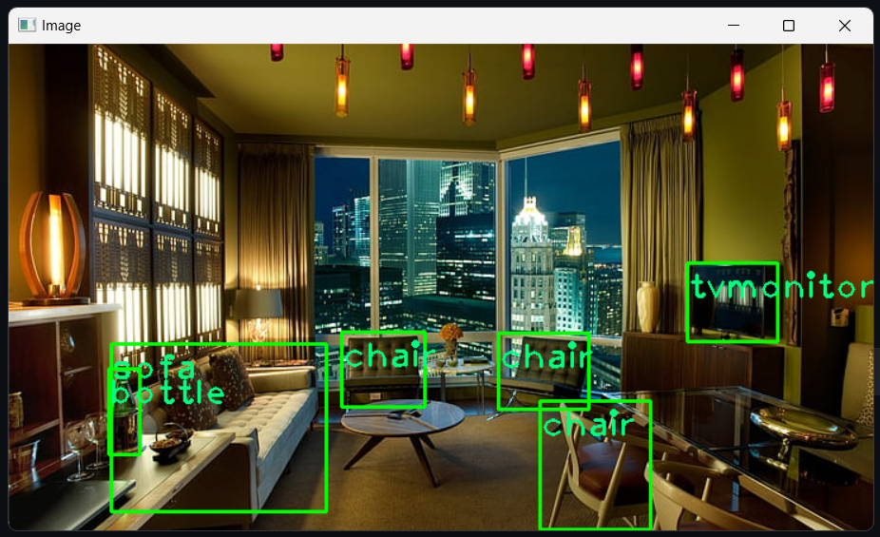
Example of Object Detection
INPUT
OUTPUT

Slide 19
Working behind face Detection in given image
I have made “no_of_face(image_path,h)”function for the object detection. It’s code uses external modules, mtcnn and opencv, which needed to be installed with command:
Then all these modules needs to be imported in code :
MultiTask Cascaded Convolutional Neural Network is a modern tool for face detection, leveraging a 3-stage neural network detector.

Slide 20
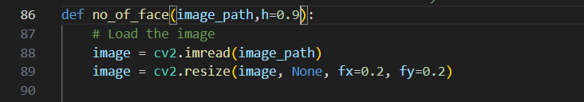
Working behind face Detection in given image…
First, the image is resized multiple times to detect faces of different sizes. Then the P-network (Proposal) scans images, performing first detection. It has a low threshold for detection and therefore detects many false positives, even after NMS (Non-Maximum Suppression), but works like this on purpose. MTCNN is very accurate and robust. It properly detects faces even with different sizes, lighting and strong rotations. It’s a bit slower than the Viola-Jones detector, but with GPU not very much. It also uses colour information, since CNNs get RGB images as input.
Then we need to load image using cv2 module:

Slide 21
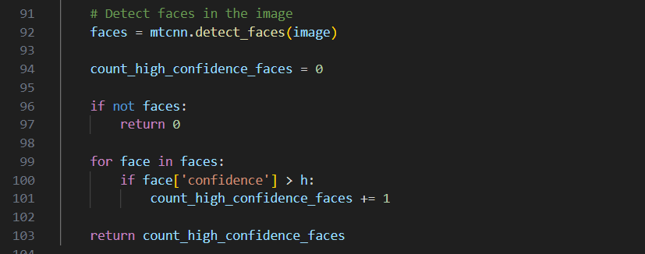
Working behind face Detection in given image…
Detecting Objects:

Slide 22
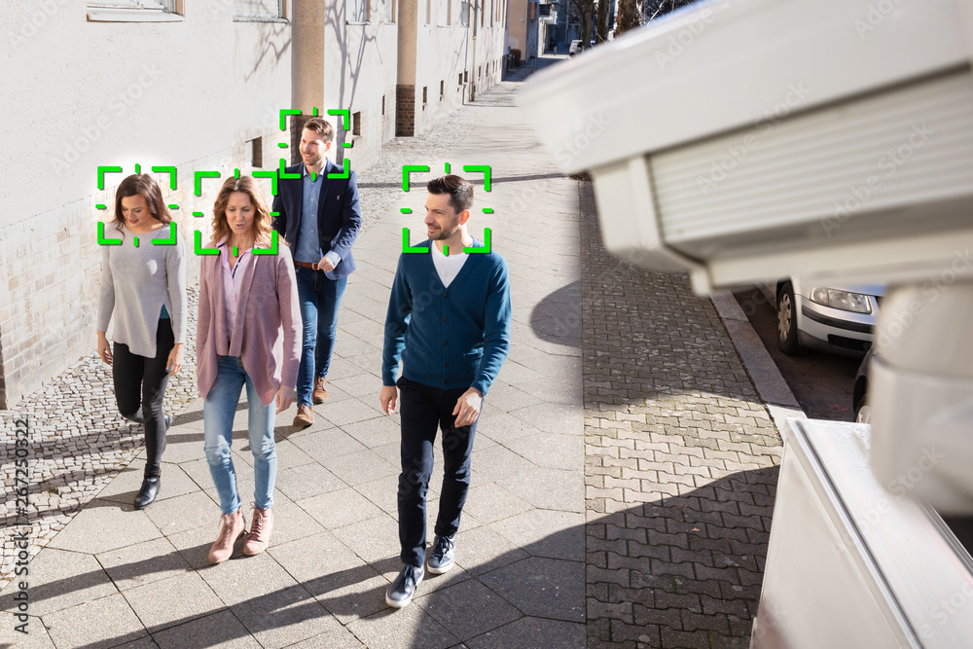
Example of Face Detetction
Input image:
Output Image

Slide 23
Working behind Real-time face Detection
I have made “no_of_face(image_path,h)”function for the object detection. It’s code uses external modules, PyQt5 and opencv, which needed to be installed with command:
PyQt5 : There are so many options provided by Python to develop GUI application and PyQt5 is one of them. PyQt5 is cross-platform GUI toolkit, a set of python bindings for Qt v5. One can develop an interactive desktop application with so much ease because of the tools and simplicity provided by this library. A GUI application consists of Front-end and Back-end. PyQt5 has provided a tool called ‘QtDesigner’ to design the front-end by drag and drop method so that development can become faster and one can give more time on back-end stuff.

Slide 24
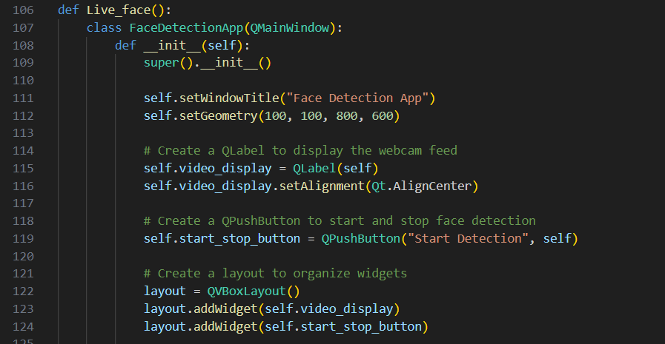
Working behind Real-time face Detection…
Code to make window for webcam access and detecting face:

Slide 25
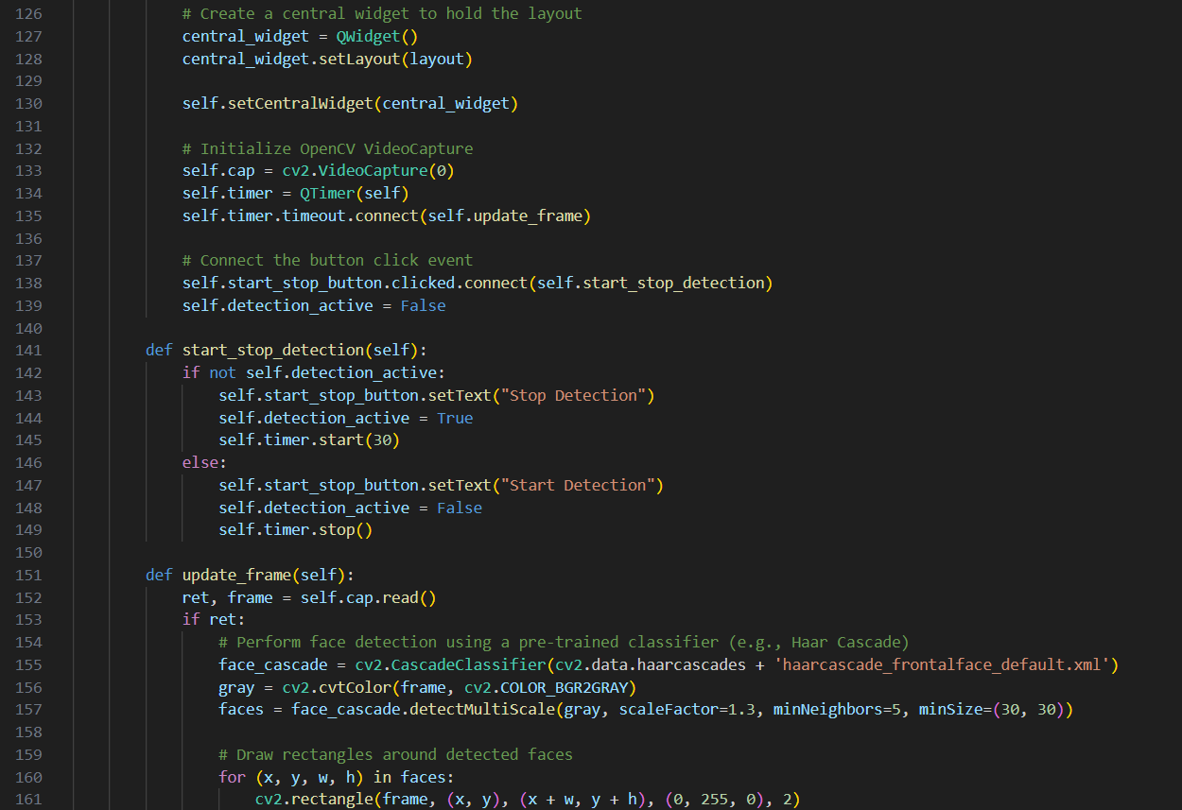
Working behind Real-time face Detection…

Slide 26
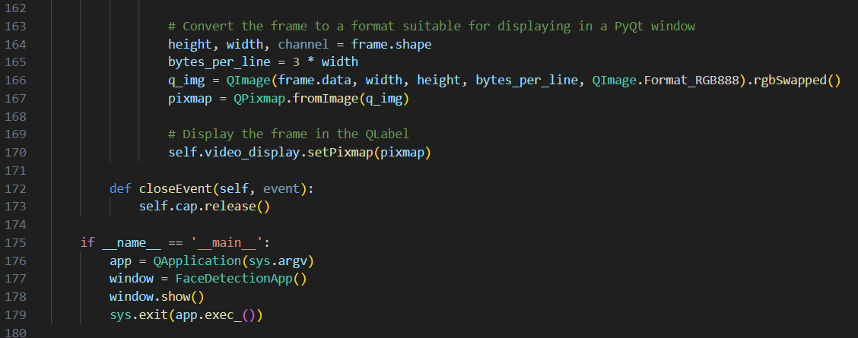
Working behind Real-time face Detection…
Output:
It will open an window showing camera footage and green square on faces.

Slide 27
Working of Streamlit
Streamlit is an open-source Python library and web application framework that simplifies the process of building interactive web applications for data science, machine learning, and data analytics. It is designed to enable data scientists and developers to create user-friendly and interactive data applications with minimal effort.
Many commands of streamlit have been used like:
import streamlit as st
St.write(“…”)
St.title(“…”)
St.header(“…”)

Slide 28
Streamlit commands used
from streamlit_lottie import st_lottie
def load_lottiefile(filepath: str):
with open(filepath, "r") as f:
return json.load(f)
lottie_pumpkin = load_lottiefile("hmm.json")
# Sidebar
st.sidebar.subheader("Navigation")
selected_page = st.sidebar.radio("Select a Page", ("Home", "Overview", "Object Detector","Face Detector", "Made By"))
st.image("123.jpg", caption="Machine Learning", use_column_width=True)
if st.button("Learn More"):
st.write(“...")

Slide 29

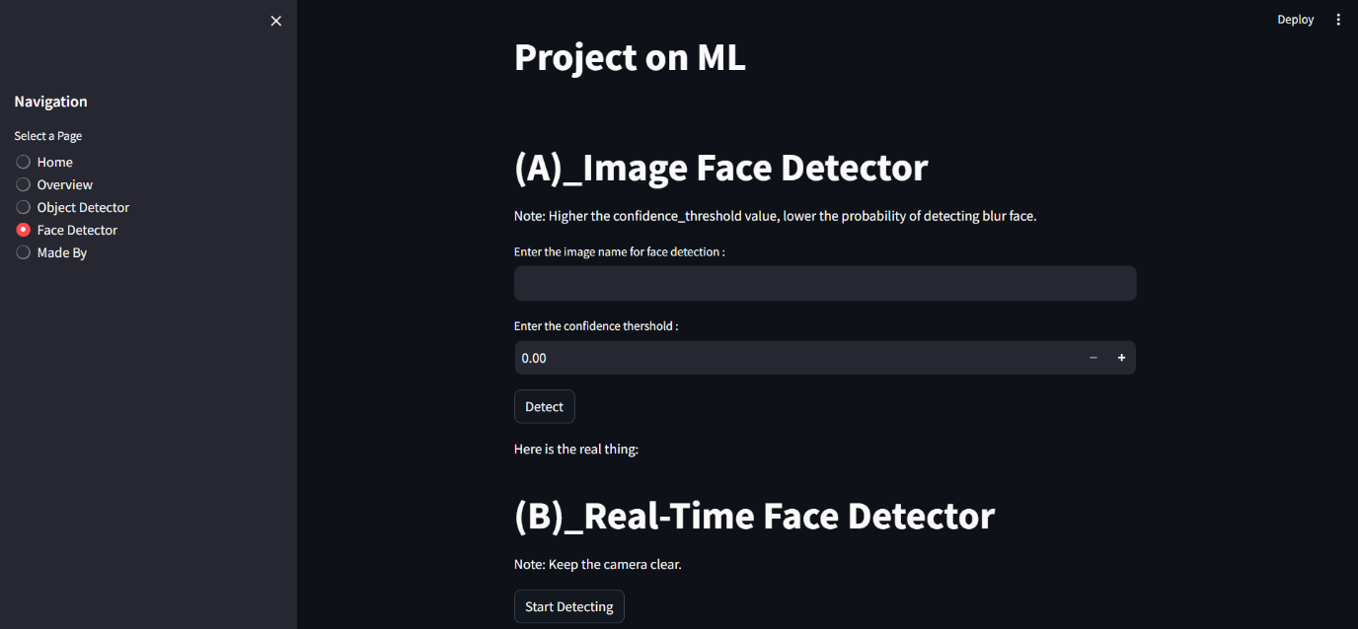
Result of Streamlit
Home Page for example
Face Detector page for example

Slide 30
Conclusion
During this project, we embarked on a journey through the captivating landscape of computer vision and machine learning, exploring the realms of object detection and face detection in both static images and real-time video streams. Our project was structured around three key components: Object Detection, Face Detection in saved images, and Real-time Face Detection, each encapsulated within dedicated functions.
The future promises exciting advancements and new horizons in machine learning, computer vision, and artificial intelligence. With a solid foundation built by projects like this, we can confidently anticipate an era where the potential of these technologies is limited only by our imagination and creativity.

Slide 31
Thanks For Watching
Made By – VAIBHAV SHUKLA
Source Code : https://github.com/mr-vaibh/face-detection-ML

